Slide 1
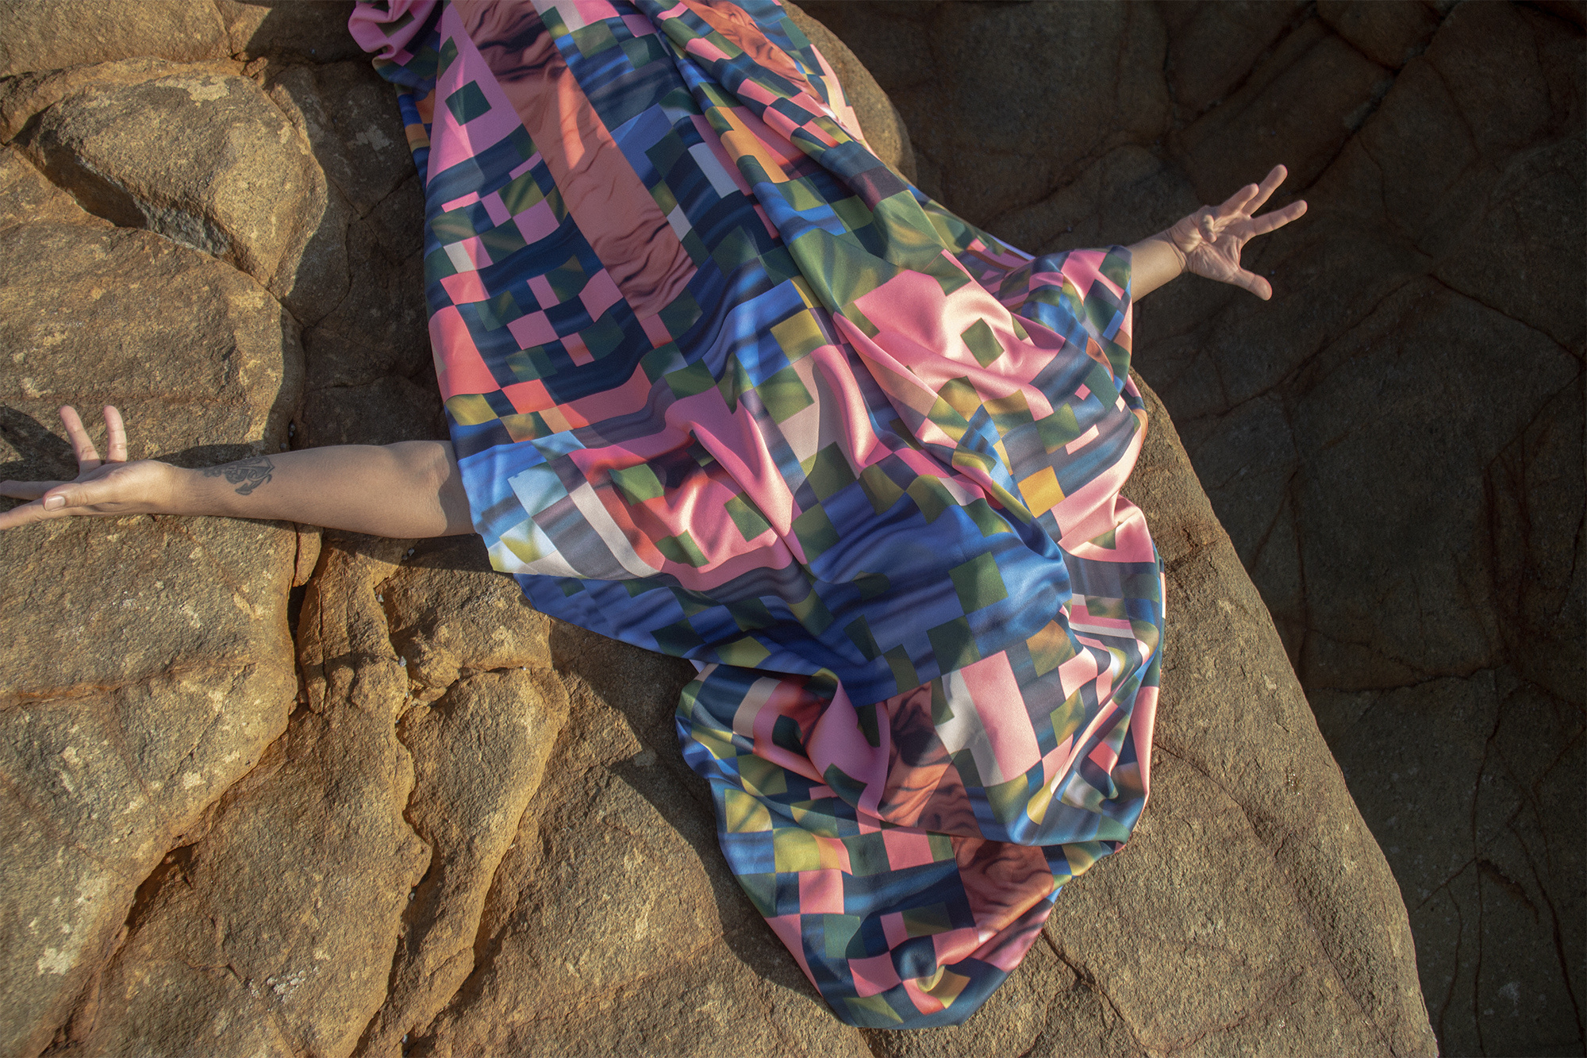


RADF GRANTS
AUGUST 2026

Slide 2

WE ARE ON KABI KABI COUNTRY
Image : Middens, Zartisha Davis - Kabi Kabi
Notes:
ACKNOWLEDGEMENT
I would like to begin by acknowledging the Traditional Custodians of the Sunshine Coast Country, the Kabi Kabi and Jinibara Peoples, and pay my respects to Elders past, present and emerging.
We recognise that long before galleries, studios and workshops, this Country was a place of story, song and making. We honour First Nations peoples as the original artists of this land and acknowledge the lasting contribution they continue to make to the creative and cultural identity of our region.

Slide 3
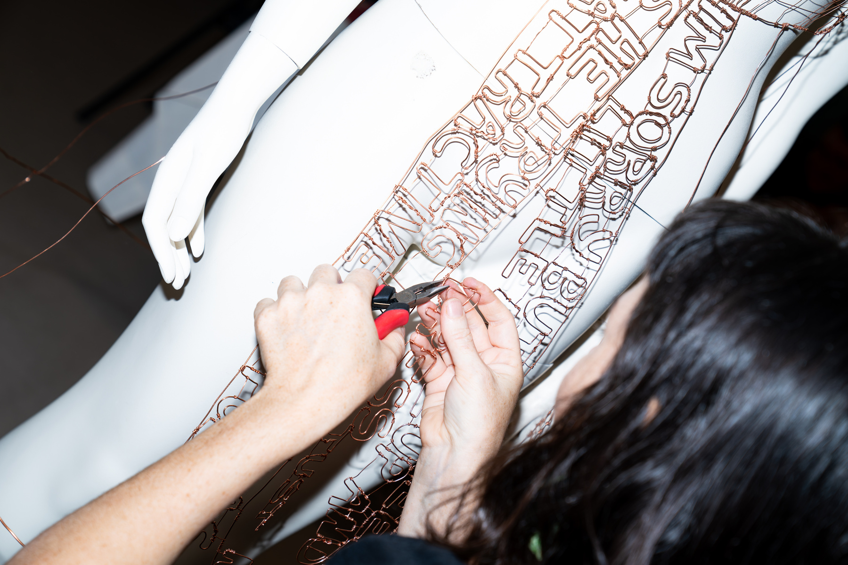
AGENDA
Guidelines
Case Studies
Grant Writing
Questions
Image : Megan Robinson, Confinement, Photo Georgia Haupt

Slide 4
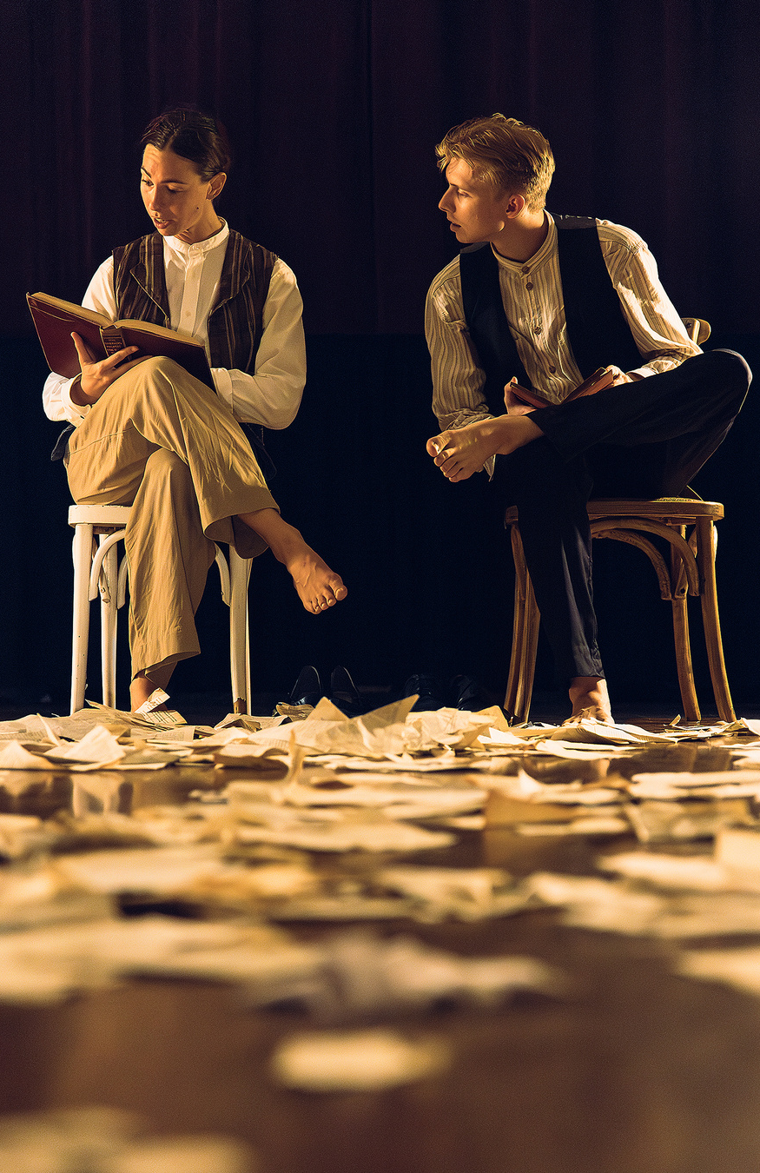


RADF GRANTS
The Regional Arts Development Fund is a partnership between the Queensland Government and Sunshine Coast Council to support local arts and culture in regional Queensland.
Image : LJ Projects, Labyrinth, Photo Travis McFarlane.

Slide 5

PURPOSE
“The Sunshine Coast is alive with arts, culture and creativity”
  Empower First Nations
  Build capacity
  Strengthen engagement
  Boost infrastructure
  Cultivate identity
ARTS PROJECTS, CAPACITY DEVELOPMENT & AUDIENCES
Notes:
RADF supports arts projects and activities that align with the Sunshine Coast Creative Arts Plan 2023 – 2038.
The program supports the Sunshine Coast creative community to develop and deliver quality contemporary arts projects, develop skills and capacity, and grow audiences and engagement, contributing to the region's cultural vitality.

Slide 6
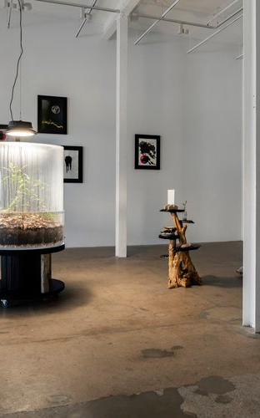
GRANT CATEGORIES
Arts Projects
  Major Projects - Funding up to $15,000
  Small Grants - Funding up to $3000
Artist Development
  Mentorship - Funding up to $5000
  Professional Development - Funding up $1500
X2 rounds per year.
Image : Myc-a, 2023 Bianca Tainsh Photo Louis Lim
Notes:
No longer have rolling rounds.
Difference between Majors and Small - scope and scale of projects and proposals. Small better suited to emerging artists.

Slide 7
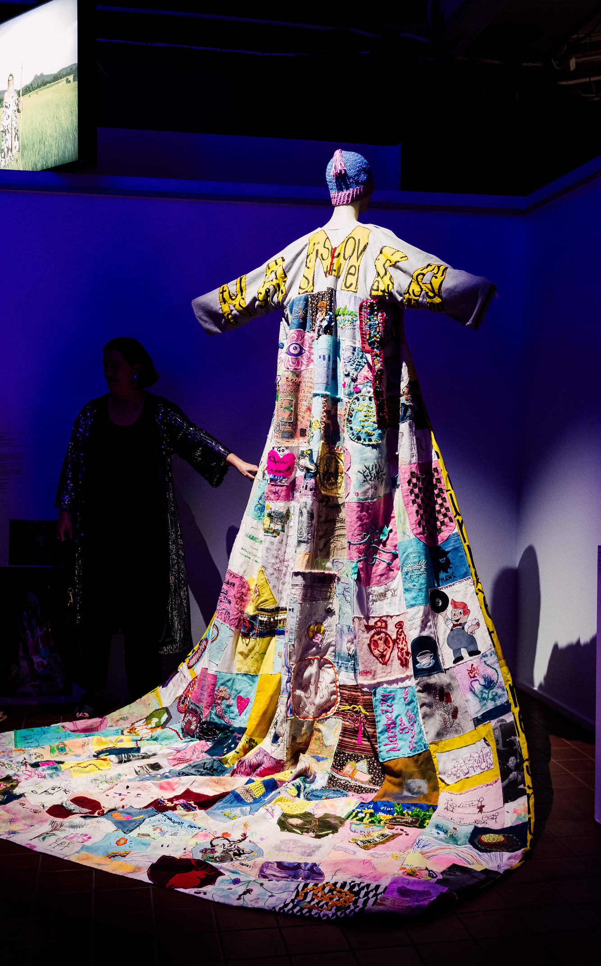
ARTS PROJECTS
Development of new artistic work.
One-off arts projects or dedicated project stages, from concept development through to presentation.
Major Projects up to $15,000
Small Grants up to $3,000
Image : Sunshine Coat Project, ShayeKet Productions, Photo Ketakii Jewson-Brown

Slide 8
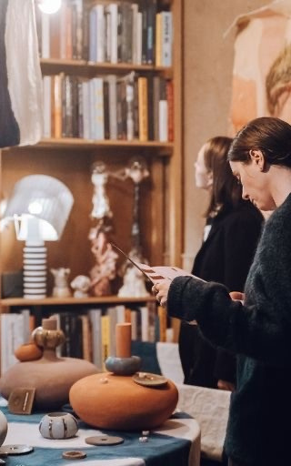
ARTIST DEVELOPMENT
Supports artists and creative workers to deepen their practice and build technical and professional skills.
Mentorship up to $5000
To undertake a structured mentorship with a suitable mentor to develop artistic practice, enhance skills and support career growth.
Professional Development up to $1500
Available for up to 50% of the cost to attend or present at significant industry conferences, workshops and events
Image : co of Sara Yael Cowan

Slide 9
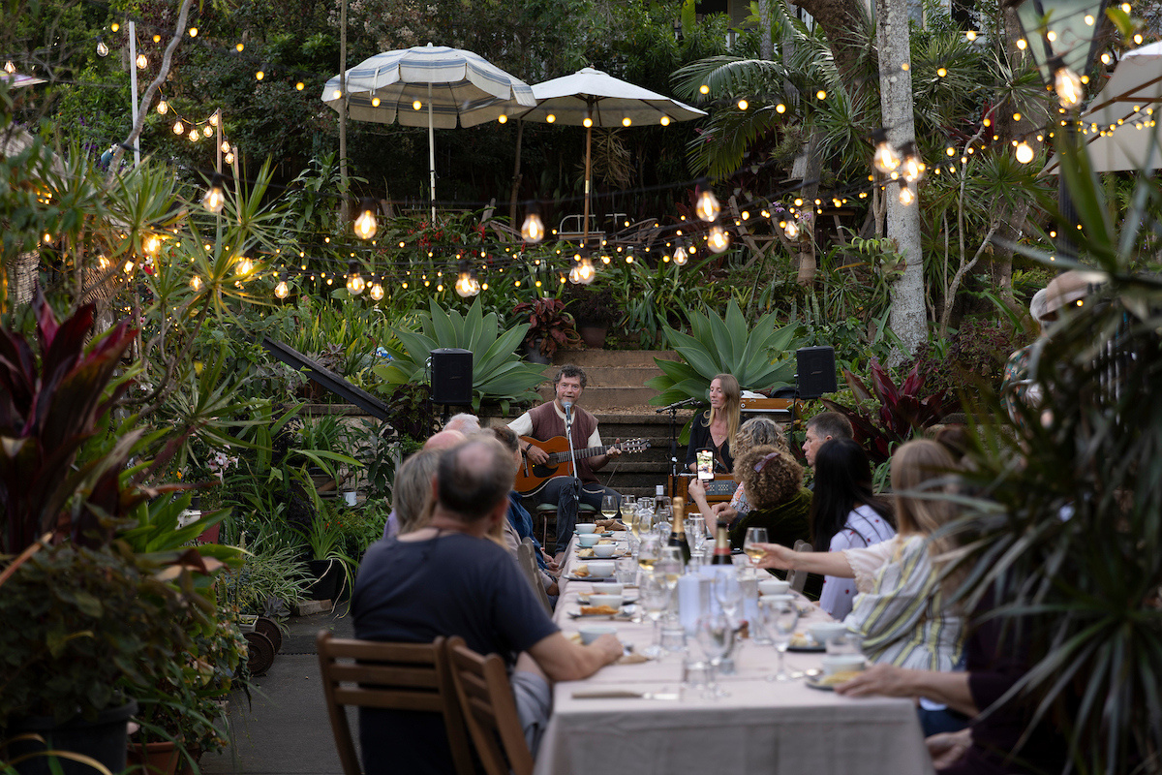
ELIGIBILITY
Who can apply for funding?
Image: Louise King, Long Listen Festival, Photo Barry Alsop.
Notes:
See guidelines for full details: https://www.sunshinecoast.qld.gov.au/living-and-community/grants-and-funding/grants-programs/arts-funding/regional-arts-development-fund
WHO CAN APPLY?
- Individuals, Groups and Orgs
- Must have an ABN
- Individuals must be AU Citizens or permanent residents.
- Must be or engage quality practicing artists
- Only one application per round
- Must not have received funding in previous round / 6 months.

Slide 10
ELIGIBILITY
Funded activities must NOT be:
  restrospective
  paying artists less than industry rates
  amateur arts activities
  educational / foundational
  solely for competition, fundraising, entertainment or commercial purposes*
  solely for printing, recording and publishing*
  awards, prizes, donations, catering
  public art or murals on Council assets or private property
  purchase of equipment or infrastructure
  business start-up costs
  staff or ongoing operational expenses
  repayment of debt or loans
  include offensive materials or themes that may damage the region’s reputation
*without a developmental outcome for artists
Notes:
RADF is designed to support eligible arts and cultural projects with clear artistic outcomes, not ongoing operations, capital purchases, education programs, fundraising activities or projects that have already commenced, and are solely for entertainment or commercial purposes.
See guidelines for full details: https://www.sunshinecoast.qld.gov.au/living-and-community/grants-and-funding/grants-programs/arts-funding/regional-arts-development-fund
Industry Rates (see meaa.org, artslaw.com.au, visualarts.net.au, asauthors.org)
Activities must have a clearly defined arts component.
Hire of equipment directly related to delivery of the project is eligible.
Art-making consumables directly related to delivery of the project are eligible.

Slide 11
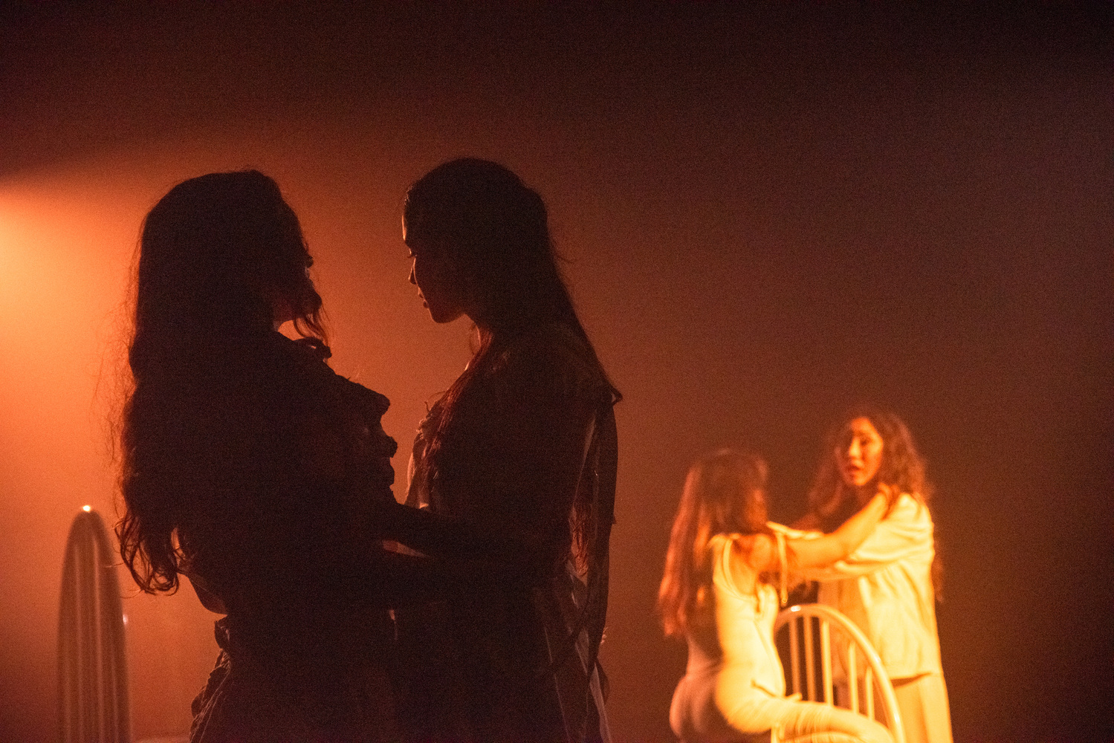
ASSESSMENT PROCESS
1. Eligibility check by Council officers
2. Independent assessment by the RADF Panel
3. Final approval by authorised Council delegate.
Image: DIVE Theatre Collective, Identity, Photo Vlad Da Cunha.

Slide 12
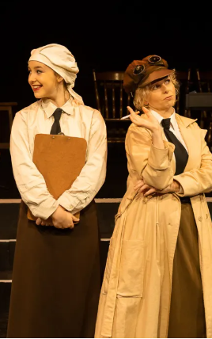
ASSESSMENT CONSIDERATIONS
Applications are assessed considering the following:
  Alignment with the Sunshine Coast Creative Arts Plan 2023-2038
  Assessment criteria; MERIT, VIABILITY, REACH, BENEFIT
  Diversity of art forms, communities and outcomes supported
Provide appropriate evidence and relevant support material.
Image : A Girls Guide to World War co. Musical Theatre Australia

Slide 13
ASSESSMENT CRITERIA
Arts Projects
Concept rationale - Clearly articulate the creative idea or concept driving your project.
Innovation and experimentation - Describe how the project is bold, original or boundary pushing.
Quality of work - Demonstrate artists and collaborators involved are experienced, highly skilled and well regarded.
Creative process - Describe the methods and artistic practices involved.
Contemporary - Explain the relevance and impact of the work to current artistic, cultural or community contexts.
Artistic outcomes - Articulate the intended high-quality arts outcomes.
Diverse - Contribution to a diverse creative community.
MERIT
QUALITY OF ARTISTIC PRACTICE & IDEAS

Slide 14
ASSESSMENT CRITERIA
Artist Development
Quality - Applicant artist and mentor / faciliator are experienced, highly skilled and well regarded.
Vision - Clear articulation of applicant's vision, goals and career trajectory
Relevance - Activity offers genuine development opportunity, relevant to career stage and supports professional growth.
Rigour - Activity is professionally recognised and demonstrates a competitive or merit based selection process.
MERIT
QUALITY OF ARTISTIC PRACTICE & IDEAS
Notes:
Professional Development
Q What was the selection criteria? Was it a competitive and/or merit-based selection process? Were you invited to participate? Can anyone apply to attend?

Slide 15
ASSESSMENT CRITERIA
Arts Projects
A clear and realistic project plan, with key stages and milestones.
Balanced and complete project budget.
Demonstrated capacity to deliver (applicant and others involved).
Evidence of consultation, partnerships and collaboration.
Evidence of engagement with relevant cultural / community groups.
Consideration of compliance and operational requirements.
Artist Development
A clear and realistic project plan.
Realistic budget.
Participation / Mentorship confirmation.
VIABILITY
CAPACITY & SKILLS TO ACHIEVE

Slide 16
VERY IMPORTANT WHO CIRCLE
(REACH & BENEFIT)
REGION
AUDIENCE
YOU
& ARTISTS
INVOLVED
PARTICIPANTS
SECTOR
PARTNERS
BEYOND

Slide 17
ASSESSMENT CRITERIA
Arts Projects
Who is the work intended for?
How many people will be able to experience it?
How will they engage with the work?
Can diverse audiences access the work?
How will you promote the project?
Artist Development
Contribution to local creative sector.
Share learnings or outcomes with peers or the public.
REACH
WHO, HOW MANY AND HOW WILL YOU REACH PEOPLE

Slide 18
ASSESSMENT CRITERIA
Arts Projects
Benefit to applicant.
Benefit to other artists.
Benefit to local arts sector.
Benefit to audiences.
Benefit to the region.
Artist Development
Contribution to local creative sector.
Share learnings or outcomes with peers or the public.
BENEFIT
WHAT CHANGE OR IMPACT WILL YOUR PROJECT MAKE

Slide 19

EDDIE RAY
KERBSIDE COLLECTIVE
ARTS PROJECTS - Major Project
  October 2023, $10,000 - Silence of the Jams 2 - Judgement Day
  October 2024, $5200 - Eddie Ray Final Development
Notes:
OCTOBER 2023 - MAJOR PROJECTS
Awarded $10,000 to create a new film filmed around the Sunshine Coast with an original soundtrack, specifically as a touring live music experience with a band. Project also engaged expertise from an established recording artist and filmmaker.
FUNDED ACTIVITIES
- Script Development (In-Kind)
- Finalise production schedule for filming.
- Song Development (potential gift program/in kind)
- Filming - Phase 1
- Revise Production schedule
- Editing
- Filming phase 2
- Home Studio Recording
- Recording at Lovestreet Studios
- Mixing and mastering tracks
- Editing
- Send for feedback
- Re-Edit
BUDGET ITEMS
- Artist Fees
- Set, props, materials
- Mentoring fee.
OCTOBER 2024
Awarded $5200 to support the final stage of the development of their new production ‘Eddie Ray – Silence of the Jams 2’, working alongside the musicians to create the live experience and document this to pitch to presenters for the second half of 2025.
BUDGET ITEMS
- Artist fees for band members
- Producer fee
- AV Tech and Stage Manager Fee
- In ears for musical director to lead band
ALSO: - MadeSC & Beyond - Marketing & Mentoring to become tour ready.
TIP: Stage your project!
PRESENTATIONS:
- Premiered at Horizon
- Brisbane Comedy Festival at Brisbane Powerhouse
- Redland Performing Arts Centre
- Coolum CIvic Centre
- Eudlo Public Hall
- Majestic Theatre, Pomona

Slide 20
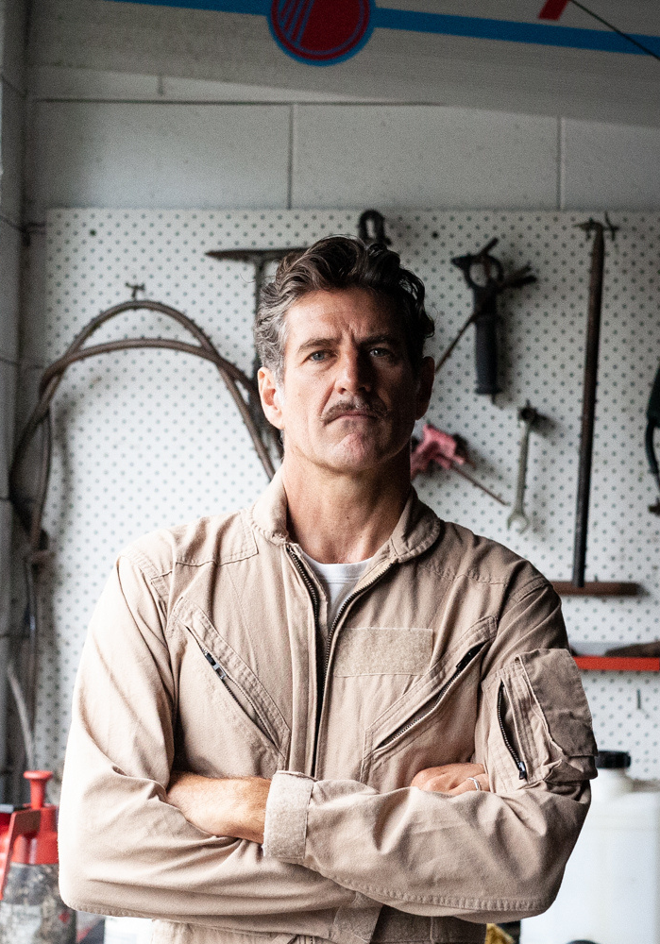
PETROL & REPAIRS
BEN BURNS
ARTS PROJECTS - Small Grant
  May 2025, $3000 - Development of Petrol & Repairs
Image: Image supplied by Ben Burns in acquittal.
Notes:
MAY 2025 - SMALL GRANT
Petrol and Repairs is a spoken word theatre performance set in a mechanic’s workshop, which uses the metaphor of a car breaking down to explore personal struggles, resilience, and recovery.
The work was already written. Funding was awarded to support creative development exploring various performance options with well renown Director and Dramaturg, as well as an industry showing.
As a recipient of the Takeover, by the Old Ambo (supported by CIIP), the project had the dedicated use of the Black Box Theatre, which allowed for the exploration of theme related industrial sounds and music, as well as lighting and tech. Two community engagement sessions were embedded into the residency, with feedback incorporated into the show.
BUDGET ITEMS
- Director and Dramaturg
- Props.

Slide 21
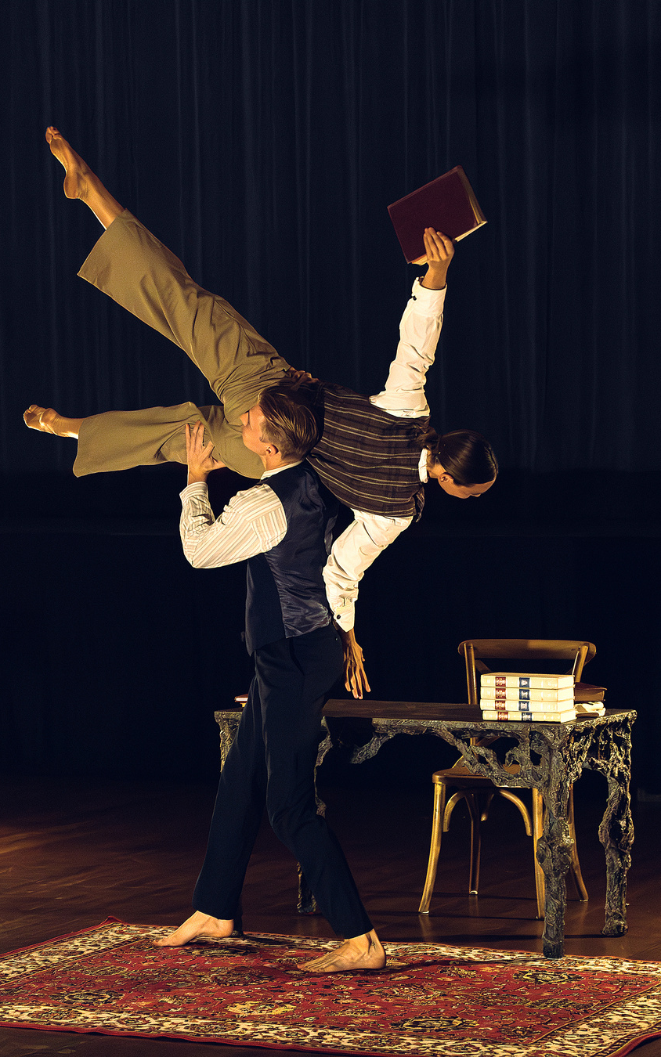
LABYRINTH
LJ PROJECTS
ARTIST DEVELOPMENT - Mentorship
  September 2025, $2280 - Labyrinth
Image : LJ Projects, Labyrinth, Photo Travis McFarlane.
Notes:
Melissa Lanham was fully funded $2,280 to engage an international touring strategist to work with LJ Projects to provide them with the tools and guidance to position Labyrinth for a successful UK tour.
Following a successful season of Labyrinth at the Adelaide Fringe Festival, the project attracted international touring interest from presenters in the United Kingdom and New Zealand. Recognising the complexity of international touring and identifying gaps in their knowledge, LJ Projects engaged international touring specialist Brendan O'Connell through a RADF mentorship opportunity.
The mentorship was structured around three key phases:
- Market Research & Presenter Mapping
- Financial Modelling & Budget Development
- Pitching Strategy & Industry Outreach
Delivered via Zoom, the mentorship provides strategic guidance from an experienced arts leader with senior programming and producing experience.
The outcome was a tailored international touring strategy to support future export and touring opportunities for the work.

Slide 22
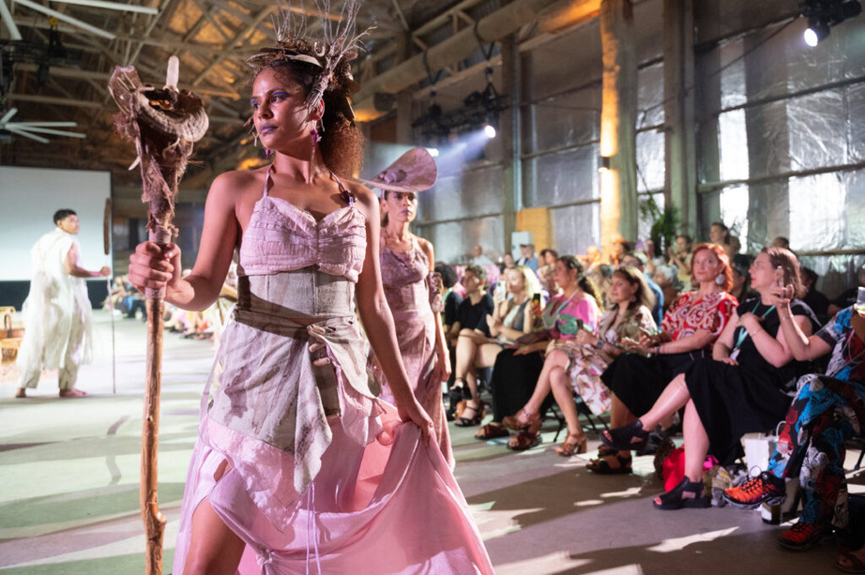
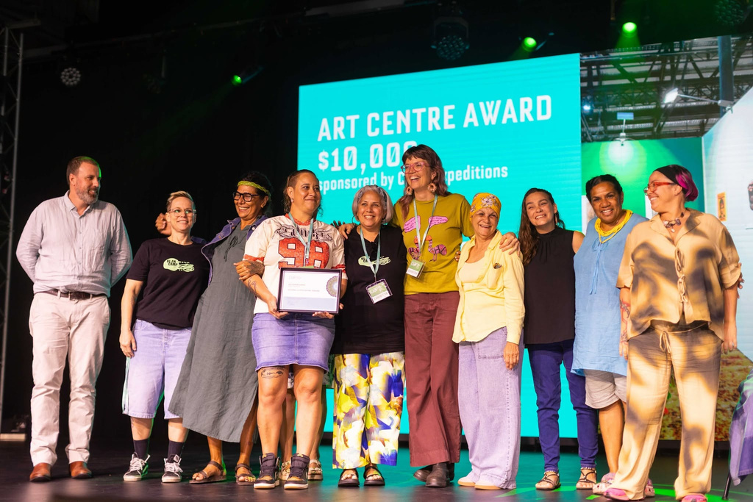
CAIRNS INDIGENOUS ART FAIR(CIAF)
ARTIST DEVELOPMENT - Professional Development
  April 2026, $1500 - CIAF
Image: CIAF 2026 Fashion - Reclamation and Regeneration - Irene Olive Adams
Image: Munimba-ja Arts Centre, recipient of 2026 CIAF Art Centre Award

Slide 23
QUESTIONS

Slide 24
THE PROJECT COMES FIRST
WHAT
WHO
WHEN & WHERE
WHY
HOW
The artform, kind & shape of your project eg research, exhibition, development of new work. What are you exploring? What are the ideas and concepts?
Artists, participants, audience, partners - sector, region and beyond.
Dates, stages and schedule eg. 2 weeks in studio, 1 week on site, 3 day exhibition
Location/s, venues, sites.
What inspired you or what are you responding to?
What change are you hoping to make, What insights, knowledge or experience do you want people to know, feel or have?
What is the process & plan? What are the stages? Think about both the creative process and logistics including engagement and marketing.

Slide 25
THE PROJECT COMES FIRST
OUTCOMES
EVALUATION & DOCUMENTATION
WORKING ON COUNTRY
SUPPORT
What are the outcomes - tangible & intangible. What are the deliverables and what changed when you delivered them.
What does success look like? How will you know? How will you tell the story? Data both qualitative & quantitively, documentation and feedback.
Have you considered how to acknowledge country and First Nations people?
Is First Nations engagement a part of your project?
How can you demonstrate your unique skills & experience? What evidence is there to support your proposal? Who actively supports your project?
How can you present this material in a powerful and professional way?

Slide 26
PROJECT DESCRIPTION
The Long and the Short – 200 - 300 Words & 50 words.
Bring together the key information you have gathered in a clear, concise and poetic way. Tell us what, who, when, where in the long and summarise for the short.
Be a little creative but not over the top. Keep it simple. Use short sentences. Avoid jargon and repetition and edit, edit, edit.

Slide 27
ACTIVITY 1
PROJECT DESCRIPTION
Example 1
Project Title: Trace / Untrace
Trace / Untrace is a new 20‑minute contemporary dance solo exploring how personal histories are carried in the body. The work investigates gestures we inherit, discard, or reclaim, drawing on interviews I have conducted with three women from migrant backgrounds. This application seeks funding for Stage 1: Creative Development only, totalling $15,000.
Stage 1 will run for a two‑week studio residency at Flow Studios with an experienced dramaturg and sound designer. During this stage, I will generate movement vocabulary, test improvisation frameworks, and establish the sonic world of the piece. The outcome will be a studio showing for invited peers, with documented feedback to guide next steps.
The project strengthens my artistic practice by allowing focused time to work with collaborators I cannot normally afford. It also responds to a growing audience appetite for intimate, narrative-driven dance work. While this application does not seek presentation funds, Stage 1 will position the work for future investment by providing a clear creative foundation, draft footage, and a dramaturgical map.
The requested $15,000 covers artist fees (in line with NAVA standards), studio hire, dramaturgy, sound design, and documentation. This development will ensure the project is artistically rigorous, ethically grounded, and viable for later presentation in 2026–27.

Slide 28
ACTIVITY 1
PROJECT DESCRIPTION
Example 2
For the past few years, my artistic practice has centred on understanding how personal and cultural memories shape movement. I have been developing my choreographic voice through various workshops and mentorships, and this project is another step in that journey. My recent interests include improvisation methods, gesture research, and the interplay between spoken text and dance, all of which I hope to explore further.
As an emerging dance artist, I’m at a point where I want to consolidate what I’ve learned and deepen my skills. I’ve recently completed a residency that expanded my confidence working solo, and I feel ready to take on a new challenge that draws on my growth. I’m also eager to collaborate more with sound artists, as I feel this is an area where my practice can evolve.
The project, Trace / Untrace, will loosely connect to my ongoing exploration of how the body stores memory. While I have some early ideas, the direction is still flexible. I intend to spend around two weeks in a studio experimenting with movement phrases, text, and sound. If possible, I’d like to show a small work-in-progress to peers.
The funding would help resource this next step in my development by supporting fees, studio hire, and some collaboration expenses. While I believe the project has potential, its form and outcomes will crystallise as I continue to refine my choreographic interests.

Slide 29
ACTIVITY 1
PROJECT DESCRIPTION
Example 3
I have been thinking about this idea for a long time. I don’t have the concept fully worked out yet, but it will be about identity. I know the project will develop once I’m in the studio - I just need money so I can book some space and pay myself and maybe get a musician involved .
There isn’t a timeline yet, but I’ll start when I get funding. I don’t really have a plan for what the outcome will be. I just need the grant to get started because making dance is expensive and I don’t have enough cash. The project might become a bigger show eventually.
The budget isn’t detailed but $15,000 should be enough for most things. I’ll refine the idea once work begins.

Slide 30
Q1. WHICH EXAMPLE IS BEST + WHY?
Notes:
Ask people to drop answers in

Slide 31
ACTIVITY 2
SUPPORT MATERIAL
Assessors want proof, not promises.
South Swell is a four-piece contemporary surf rock band based on the Sunshine Coast. They are applying for funding to record their album, Ocean After Dark, a 10-track body of work inspired by the region's coastline, ocean landscapes and laid-back coastal lifestyle. Exploring themes of connection, self-discovery and resilience, the album reflects the rhythm of life by the sea, from late-night beach walks and moonlit tides to the freedom and renewal found in the natural environment. Blending surf rock energy with contemporary indie influences, Ocean After Dark captures the distinctive character of the Sunshine Coast and shares authentic regional stories through original music.
PROVIDE EVIDENCE TO SUPPORT YOUR PROPOSAL

Slide 32
Merit
Viability
Benefit
Reach
Q2. WHAT SUPPORTING MATERIAL SHOULD BE INCLUDED IN THE APPLICATION?
Notes:
Think about Merit, Viability, Benefit and Reach.
Next slides will give examples.

Slide 33
Merit
Viability
Benefit
Reach
  High‑quality demo tracks or previous releases
  Recent live performance video
  Tracklist + creative rationale for the album concept
  Band bios showing experience / achievements
  Reviews, press coverage, playlist adds, radio spins
  Tour history or evidence of audience growth.

Slide 34
Merit
Viability
Benefit
Reach
  Studio quote and confirmation of availability
  Mixing/mastering quotes
  Project timeline from pre‑production to release
  Detailed budget
  Letters of support from scene leaders, music organisations, regional venues
  Letters of support from potential collaborators (featured artists, designers, etc.)

Slide 35
Merit
Viability
Benefit
Reach
  Letters of support from scene leaders, music organisations, regional venues
  Letters of support from potential collaborators (featured artists, designers, etc.)
  Relevant research, strategies, plans, data
  Examples of previous outcomes from like projects.

Slide 36
Merit
Viability
Benefit
Reach
  Audience analytics (Spotify, YouTube, Apple Music)
  Social media insights (engagement rates, growth data)
  Mailing list or fan community size
  Touring history + attendance numbers
  Venue or festival interest emails (expressions of interest for tours after album release)
  Radio airplay reports
  Press/media coverage (blogs, reviews, interviews)
  Distribution plan (label support, digital distributor confirmation)
  Marketing strategy & release plan (timelines, PR activities, content plan)
.

Slide 37
BUDGET
INCOME
What comes IN including tickets sales, sponsorship, other grants, your own contribution and in-kind contributions.
EXPENDITURE
What goes OUT including all project expenses - artists fees, venues, production costs and materials, marketing, insurances and documentation.
INKIND
the 'dollar value' of assets or contributions to the project without cash payment for example volunteer hours, discounts or equipment of your own.
DEMONSTRATE UNDERSTANDING OF WHAT IS INVOLVED TO DELIVER YOUR PROJECT THROUGH YOUR BUDGET

Slide 38
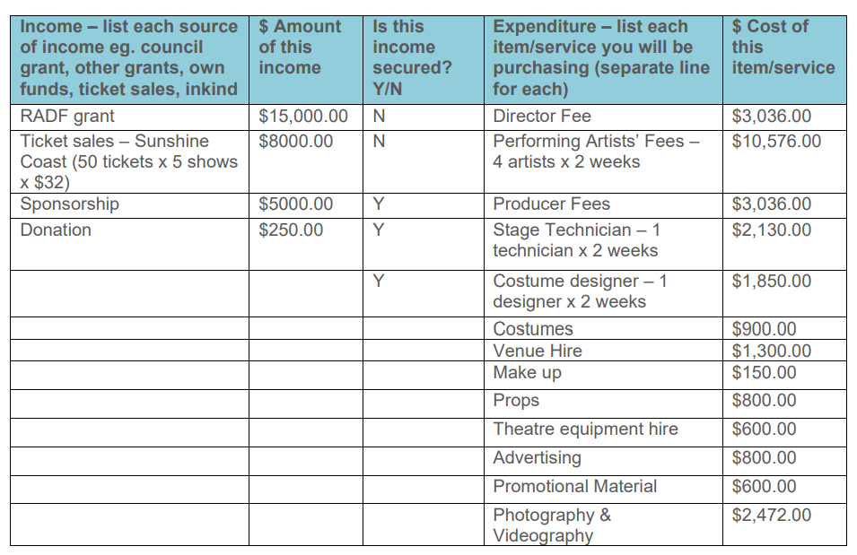
CASH
BUDGET
Total Income (Cash) - $28,250
Total Expenditure (Cash) - $28,250
DEMONSTRATE UNDERSTANDING OF WHAT IS INVOLVED TO DELIVER YOUR PROJECT THROUGH YOUR BUDGET

Slide 39
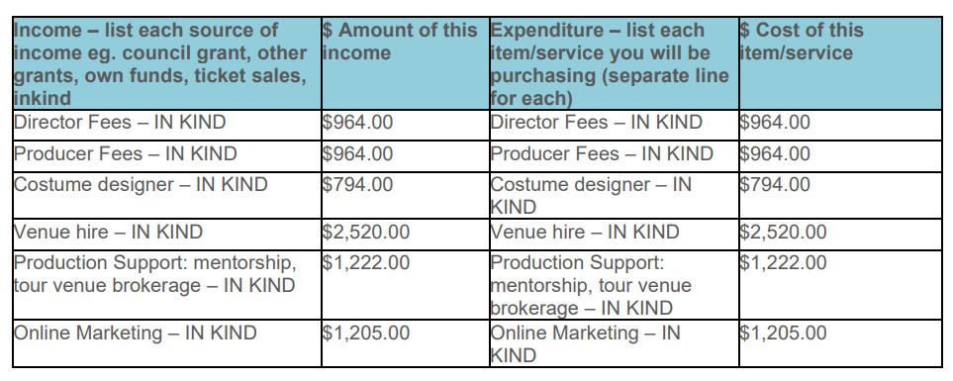
In-kind
BUDGET
Total Income (In-Kind) - $7669
Total Expenditure (In-kind) - $7669
Total project cost (Cash + In-kind) $35,919
You will be asked to list the items from your budget that you are requesting funding for.
DEMONSTRATE UNDERSTANDING OF WHAT IS INVOLVED TO DELIVER YOUR PROJECT THROUGH YOUR BUDGET

Slide 40
THANK YOU & WRAP UP!

Slide 41
RADF GRANTS
ONE ON ONES
If you still have questions, contact the RADF Officer at:
artsfunding@sunshinecoast.qld.gov.au
To help us respond efficiently, please include the following information with your enquiry:
  Applicant name
  Project name
  Your location
  Proposed project dates
  Brief project description (2-3 sentences)
  Links to your work (website and/or social media).
Notes:
We will send you links to book a free 30-minute consultation with a RADF Officer following this presentation. The session provides an opportunity to discuss your project idea and receive guidance to help plan your application.
Alternatively, email us with the following information (see slide).

Slide 42
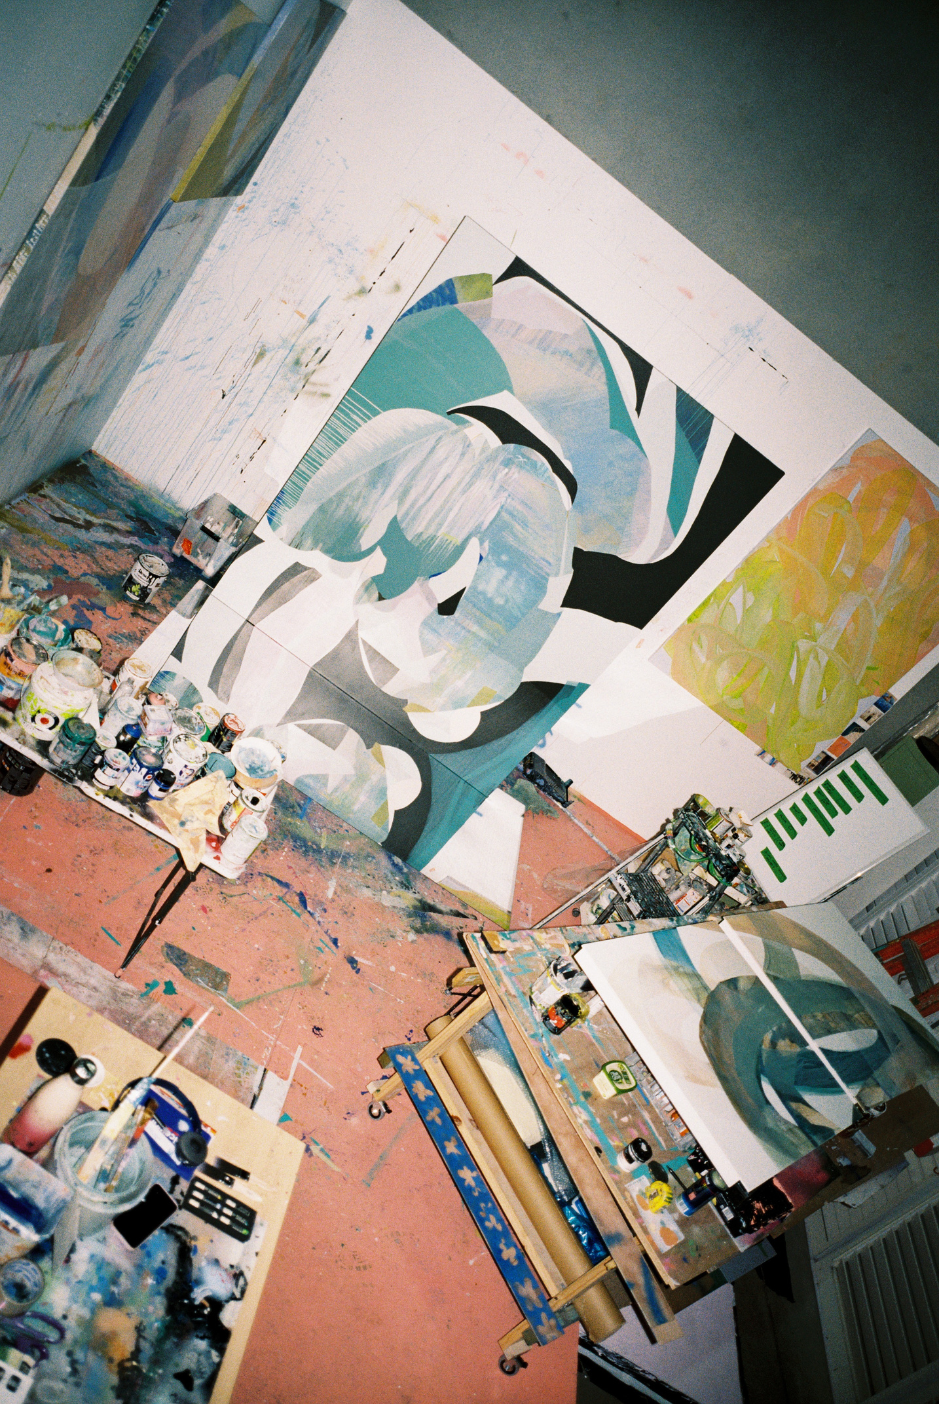
STAY IN TOUCH
ARTISTS EDITION
Sunshine Coast Council opportunities for artists
THE GUIDE
SCCA’s guide to opportunities for artists in the region

Slide 43
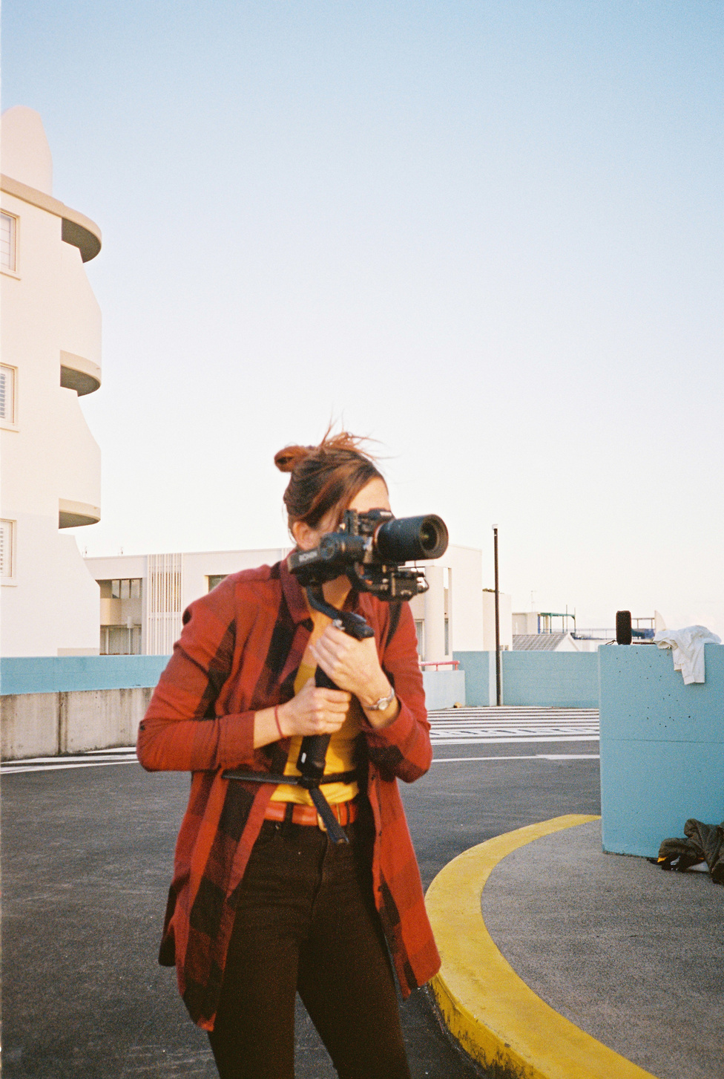
RESOURCES LOCAL
Sunshine Coast Council Community Grants
Sunshine Coast Creative Alliance (SCCA)
Sunshine Coast Arts Foundation
Sunshine Coast Screen Collective
Sunshine Coast Music Industry Collective
Regional Arts Services Network (RASN)

Slide 44
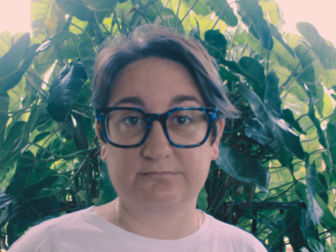
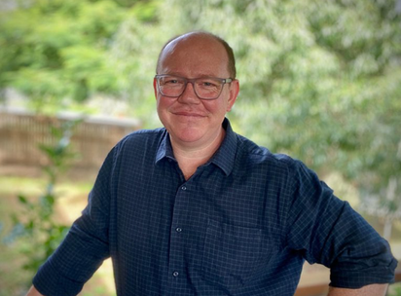
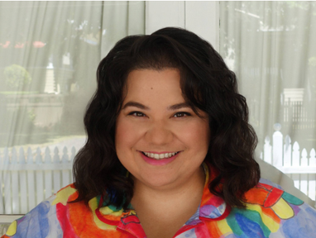
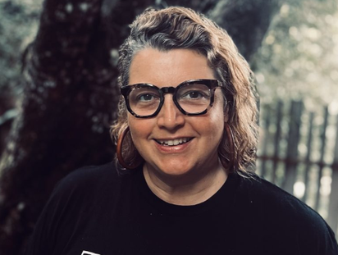
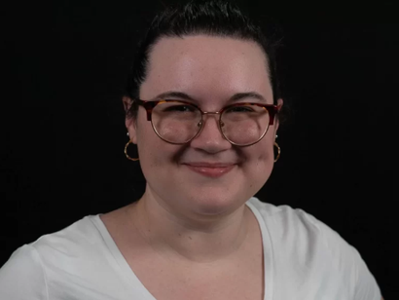
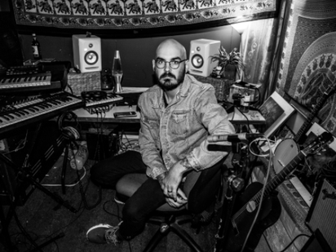
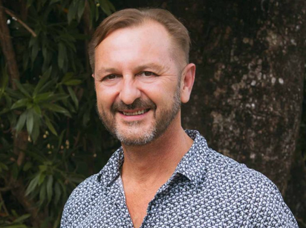
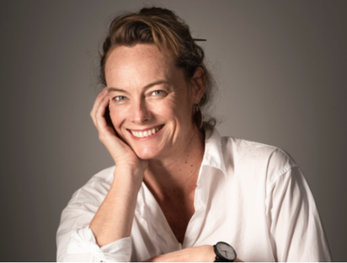
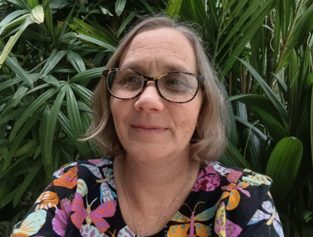
RASN TEAM
REGIONAL ARTS SERVICES NETWORK
WWW.RASN.AU
  Shannon Garson, Craft & Design - artisan
  Leilani Seeto, Dance - Ausdance Qld
  Belinda Simonsen, Local Government - Topology
  Robyn Fernandez, Visual Arts - Flying Arts Alliance
  Alex Henriksson, Music - QMusic
  Charles Wiles, Multi-arts - Festivals, & Community Engagement, Topology
  Jessica Lamb, Theatre - JUTE Theatre Company
  Cassandra Ramsay, Theatre - JUTE Theatre Company
  Luke Harriman, RASN Statewide Service Manager - Topology
Notes:
Regional Arts Services Network is an initiative of the Queensland Government through Arts Queensland.
RASN connects the dots for artists and arts organisations by:
- Brokering new connections between artists, organisations, communities and opportunities
- Providing advice and feedback on projects, ideas, and funding applications
- Offering mentoring and professional guidance
- Building and strengthening arts and cultural networks across our regions
- Showcasing the incredible talent and stories that can be found across our communities
- Sharing industry resources and information to support professional development
- Supporting local government arts and culture staff
- Promoting and advocating for regional artists and creative industries.
They have regionally based Arts Advisors offer free, tailored support to artists and arts organisations working across a range of creative disciplines.
Capacity Building – Bolstering the skills and capabilities of artists and arts workers through workshops, mentorship, and professional development programs.
Strategic Brokering – Connecting artists with funding bodies, stakeholders, industry partners, and opportunities statewide.
Coaching and Mentoring – Offering expert advice on grant writing, project development, and navigating the arts business landscape.
Resources and Learning – Sharing practical tools and information that assist artists to find knowledge and investment that supports sustainable creative livelihoods.
You can make a booking to meet with a RASN Arts Advisor through their website.
COMING UP:
Music - Industry Connect, presented with QMusic.

Slide 45

SCAF
SUNSHINE COAST ARTS FOUNDATION
WWW.SCARTSFOUNDATION.COM
  Applications open: 1 August 2026
  Applications close: 30 September 2026
  Recipients Announced: 23 October 2026
  Funding available: $5,000
Notes:
Sunshine Coast Art Foundation (SCAF) promotes the development and prosperity of the arts on the Sunshine Coast through fundraising and philanthropic investment that facilitates artistic vibrancy and engages the public imagination.
SCAF's Gifted Program is Now Open.

Slide 46
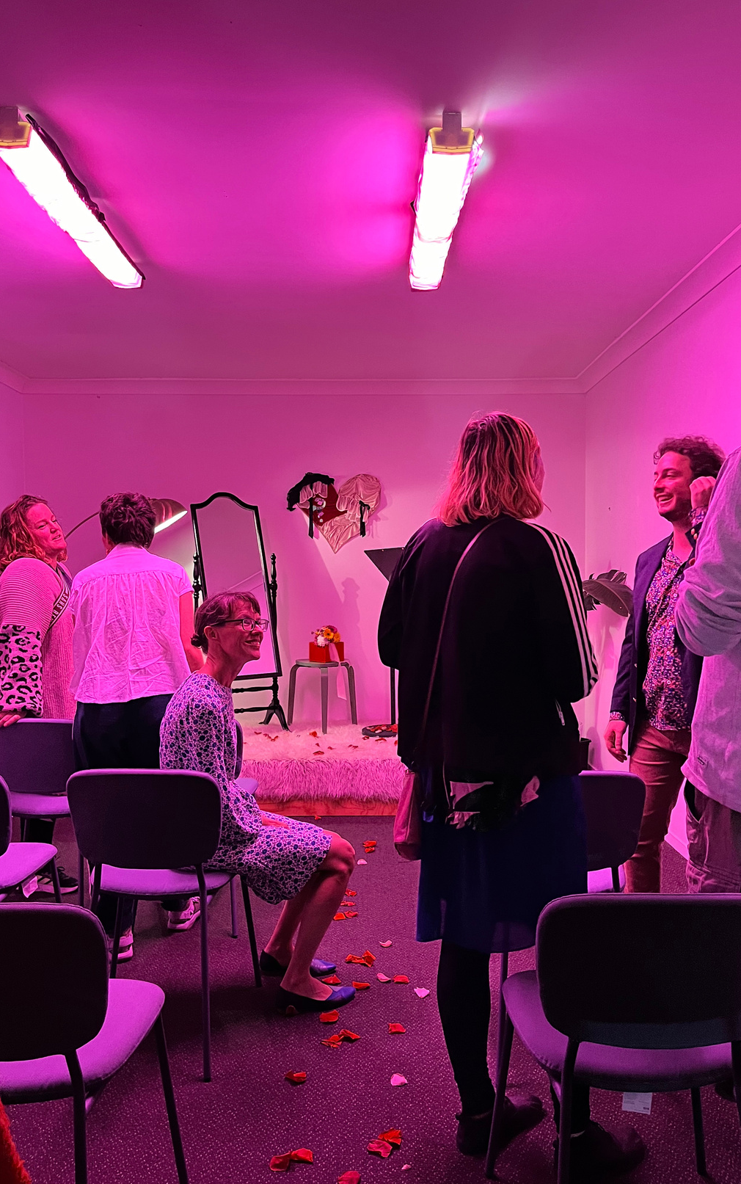
RESOURCES
GOVERMENT
Arts Queensland
Creative Australia
Notes:
ARTS QLD
- QLD Art Project Fund - Open Now. Closes 14 September
- Touring QLD Fund - Opens 31 August 2026 and closes 12 October 2026.
CREATIVE AUSTRALIA - Open Now. Close 1 September.
- Arts Projects for Individuals Groups
- Arts Projects for Organisations.

Slide 47
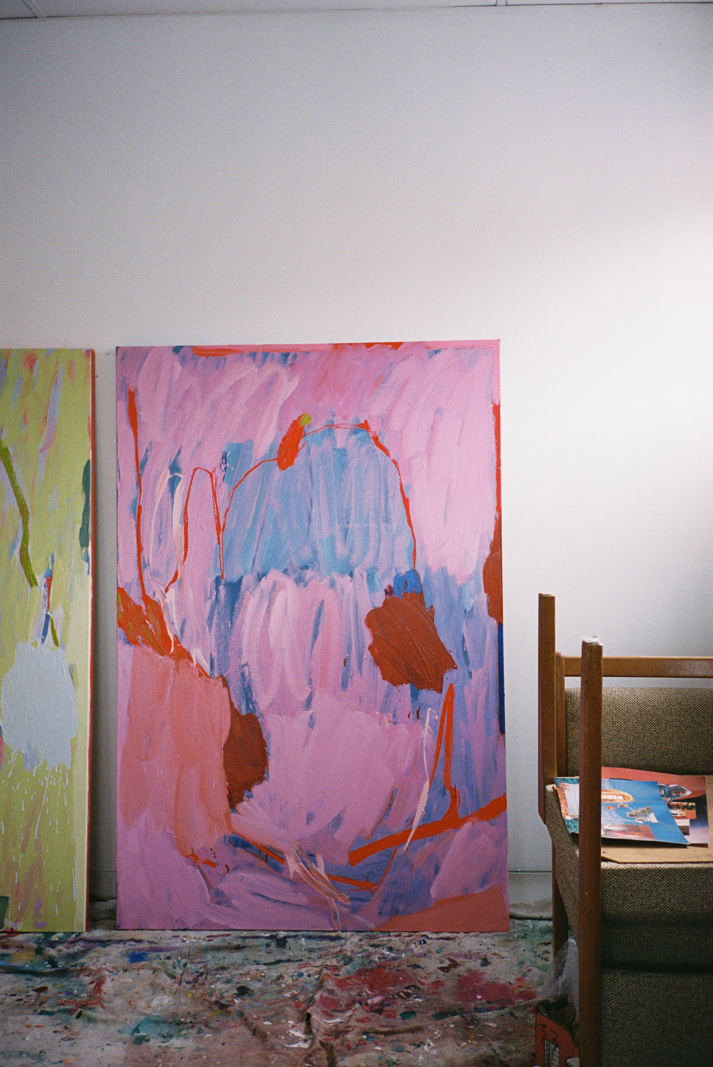
RESOURCES ORGS.
Regional Arts Australia
Flying Arts Alliance
National Association for the Visual Arts (NAVA)
Australian Writer's Guild & Queensland Writer's Centre
Media and Entertainment Arts Alliance (MEAA)
QMusic & Australian Music Association
Arts Law
Screen Queensland & Screenworks
Ausdance QLD
Q Touring

Slide 48
THANK YOU & BYE!

